Slide 1
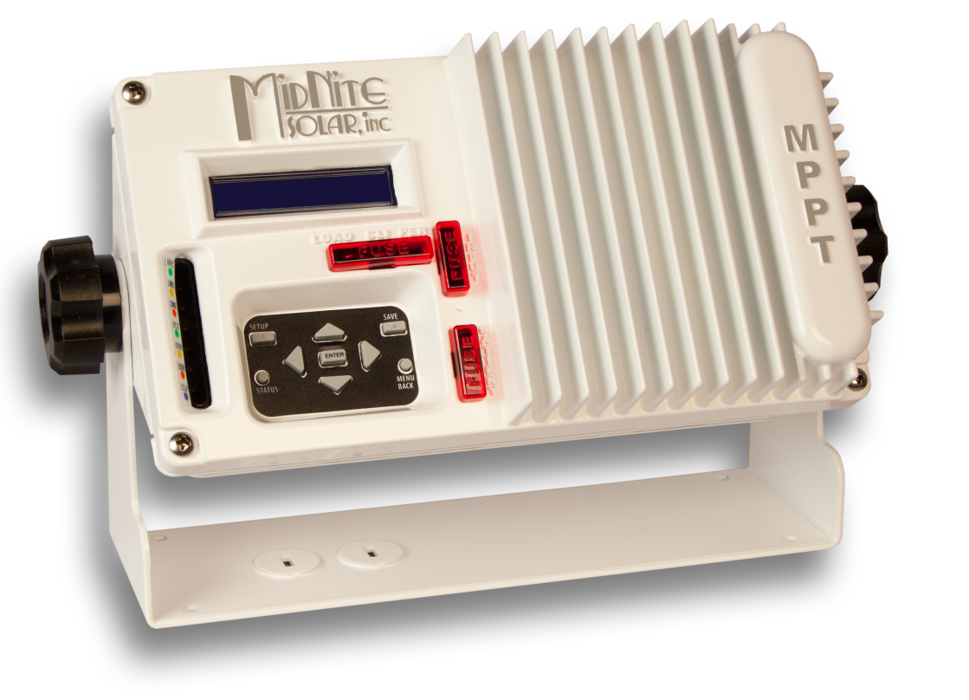
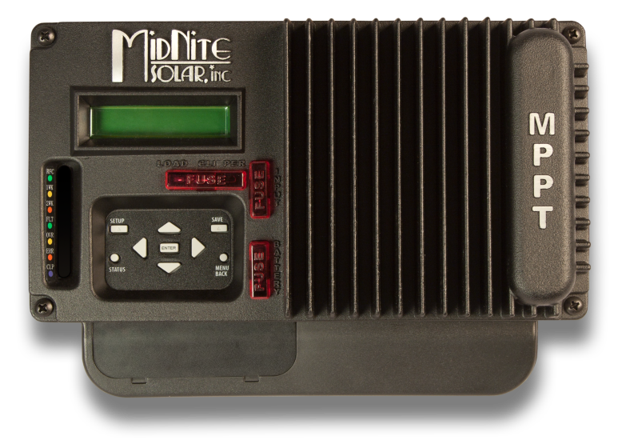
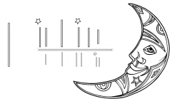
THE KID
The finest 30 amp MPPT charge controller for Solar, Wind or Hydro

Slide 2
THE KID VERSATILITY
The KID is the most versatile 30 amp charge controller on the market, ideal for small renewable energy systems.

Slide 3
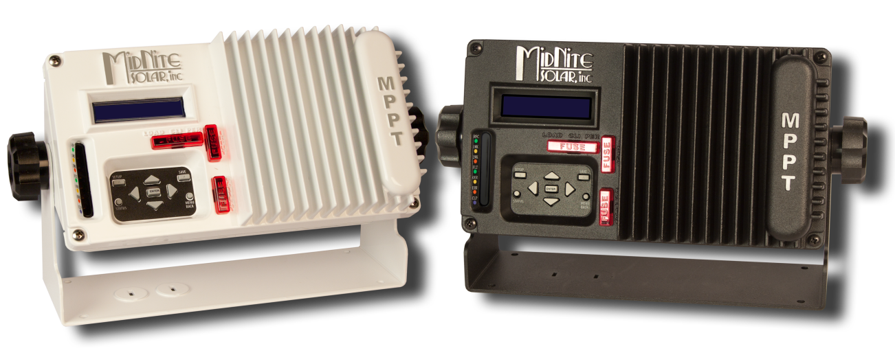
THE MARINE - RV KID
The KID comes in a marine/RV version that includes a boat mount kit, battery temp sensor, extended conformal coating and is available in black or white.

Slide 4
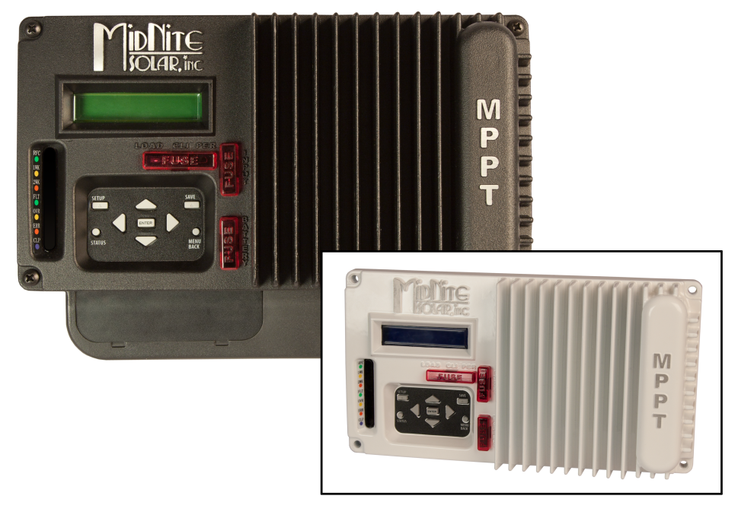
LIGHTING CONTROLLER
The MidNite KID controls lighting for dusk-dawn, hourly, day and night settings.

Slide 5
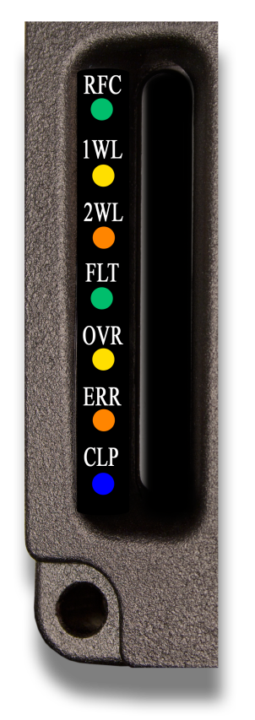
THE KID LED MODES
The KID has a three LED bar graph plus four status LEDs that display a variety of information.
RFC (Green) – Recently received full charge
1WK (Yellow) – 1 week since full charge
2WK (Orange) – 2 weeks since full charge
FLT (Green) – Battery is in float charge
OVR (Yellow) – Over Voltage, Current or Temp
ERR (Orange) – The KID has stopped due to error
CLP (Blue) – The KID Clipper /load is on

Slide 6
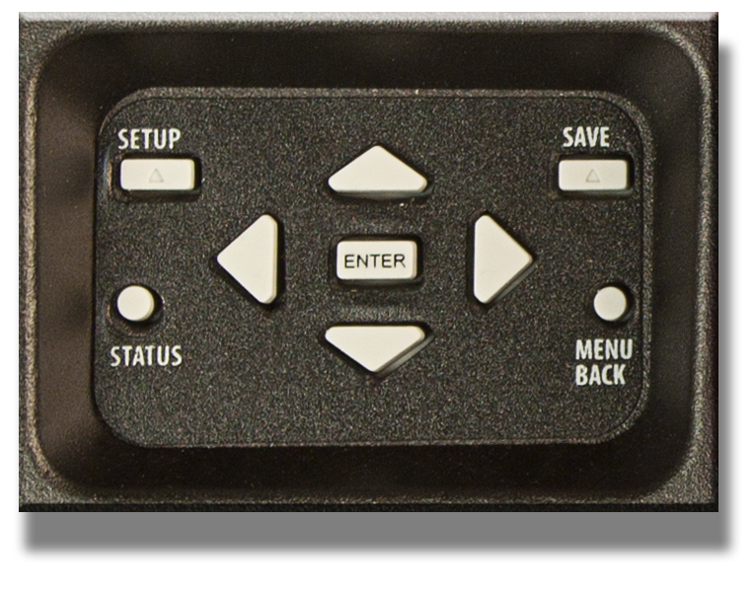
LCD DISPLAY & KEYPAD
The KID has a two line LCD display with keypad access for easy programming and data display/data logging
KEYPAD BUTTONS
Setup
Status
Save
Menu Back
Enter
Up, Down, Right & Left arrows

Slide 7
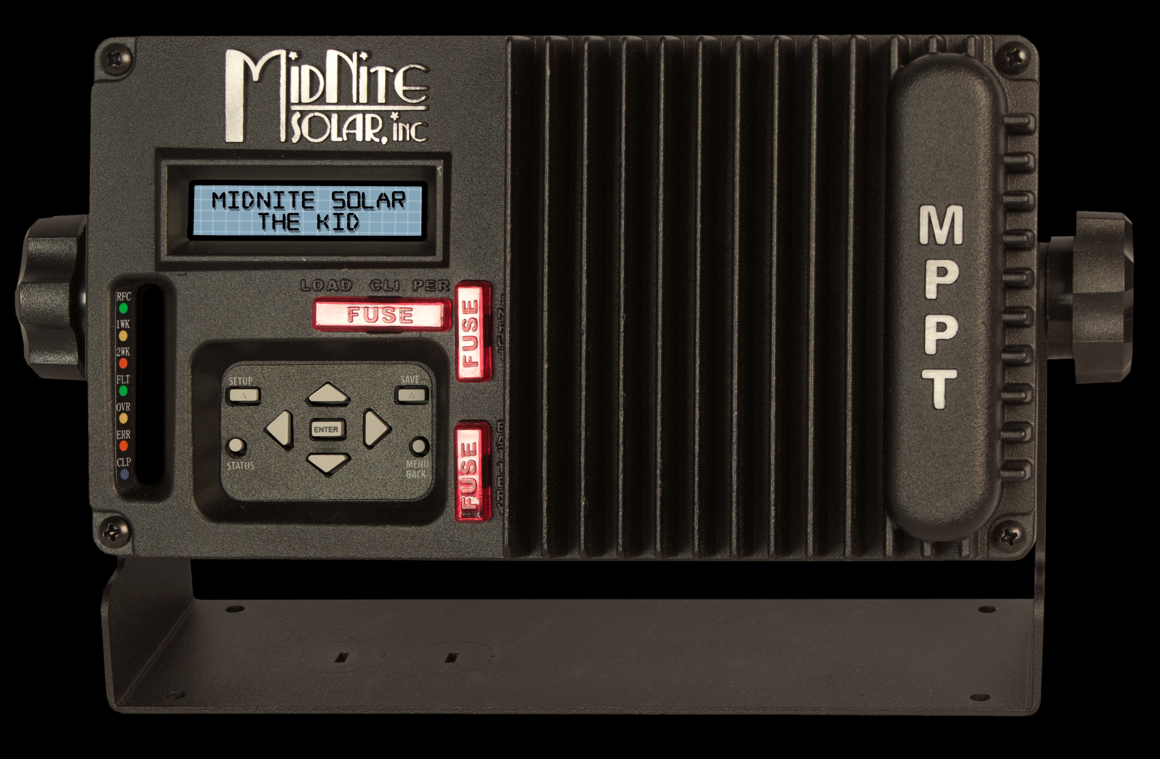
DATA LOGGING
Time in Float
kWh/amp hours per day
Lowest battery voltage for the day (not including short term surges
Whizbang Jr. net amp hours +/-

Slide 8
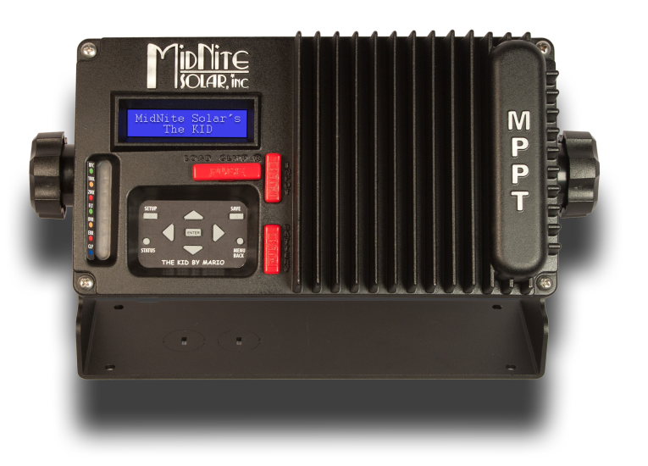
TRUE INPUT PARALLELING
The KID allows for true input paralleling. As your power needs grow, add more modules to the array and a second KID. This will allow twice the power from a single array.

Slide 9
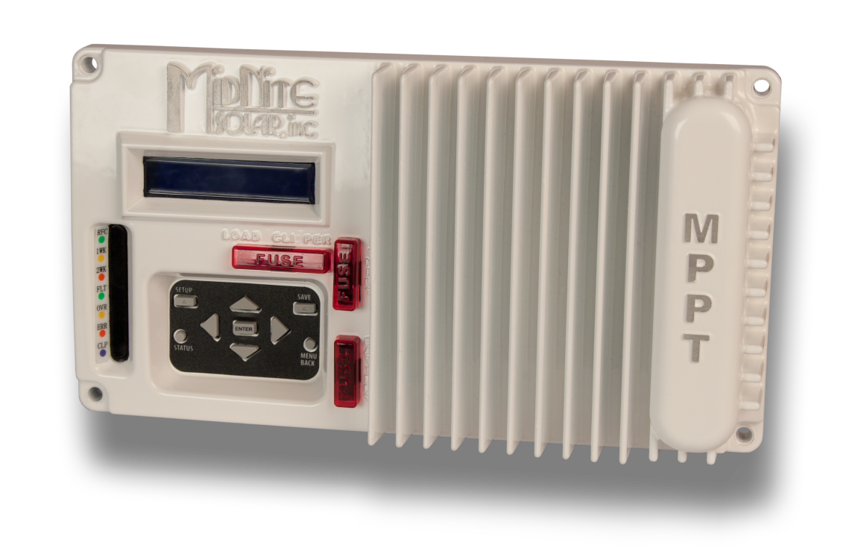
POWER HANDLING
12V Battery – Up to 500W PV array
24V Battery – Up to 750 to 1000W PV array
48V Battery – Up to 1500W PV array

Slide 10
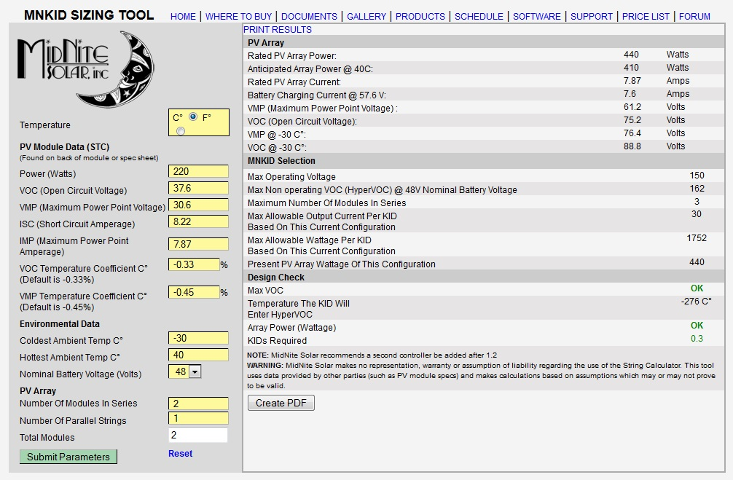
STRING SIZING

Slide 11
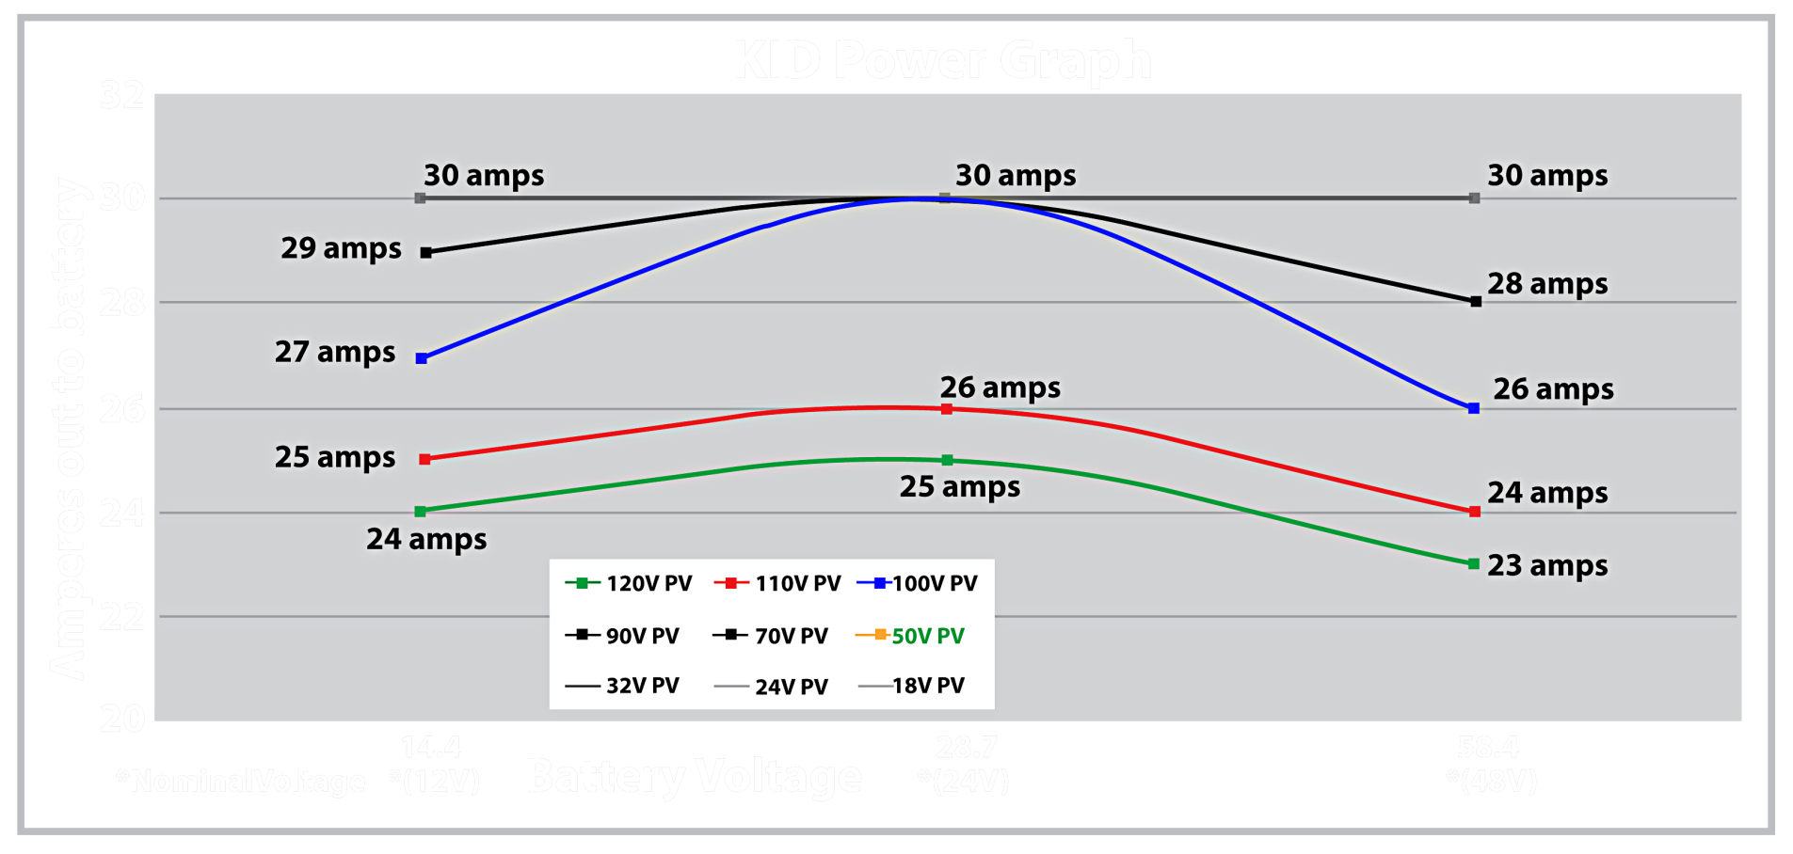
POWER GRAPH
PV Voltage levels shown are Vmp values.
Voc will be approximately 20% higher.

Slide 12
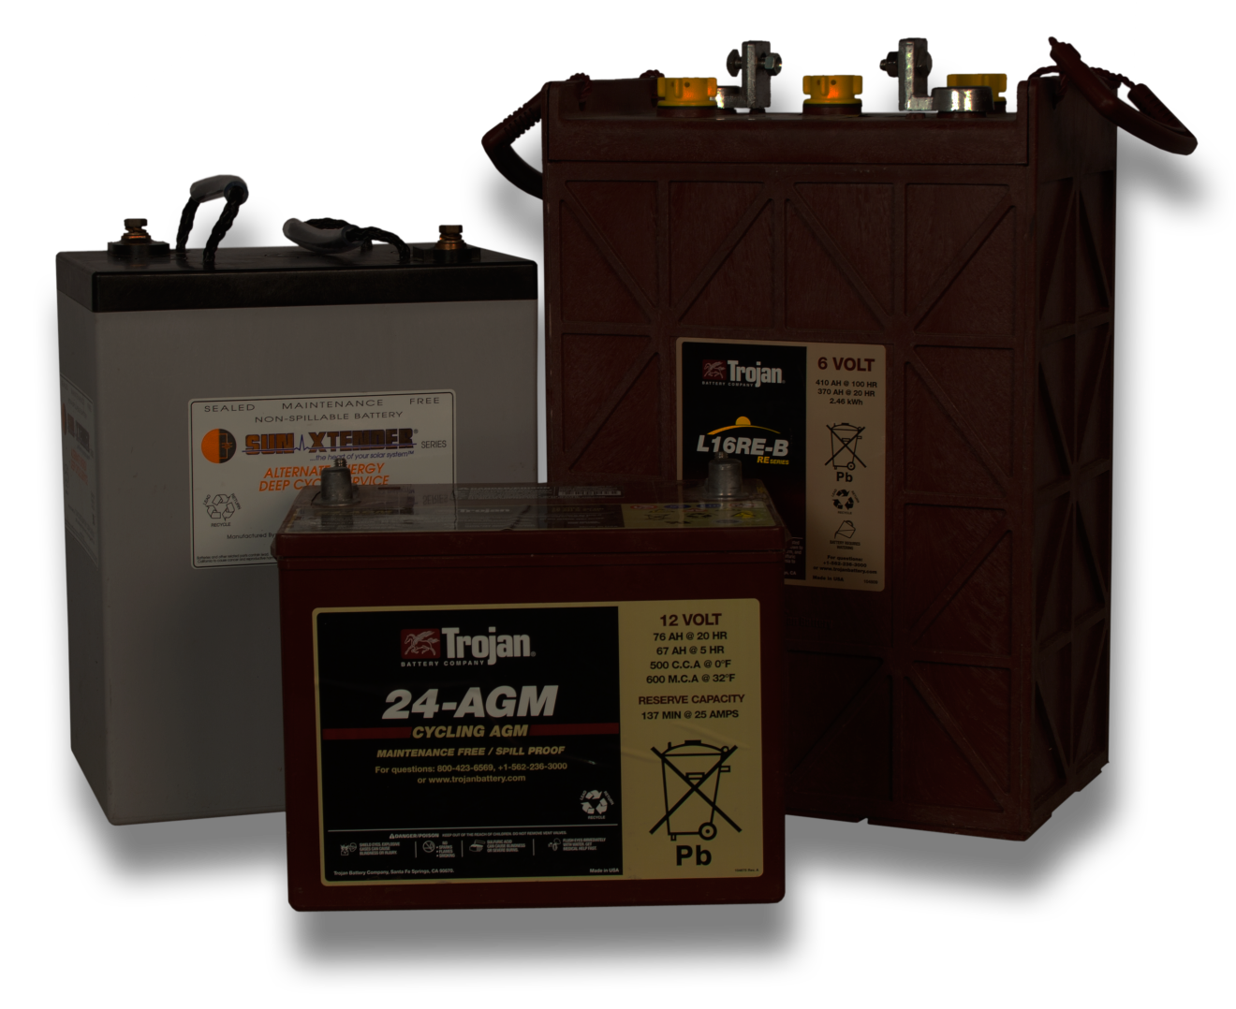
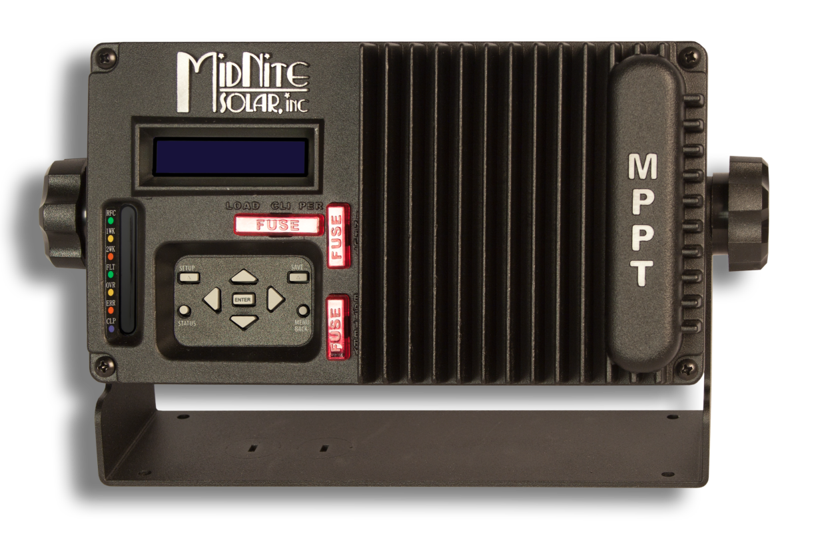
BATTERY SUPPORT
The KID supports 12, 24, 36 and 48 volt battery systems and virtually any chemistry.

Slide 13
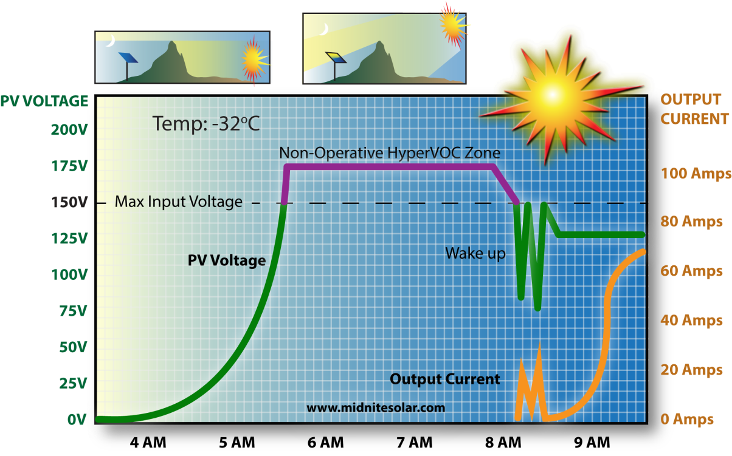
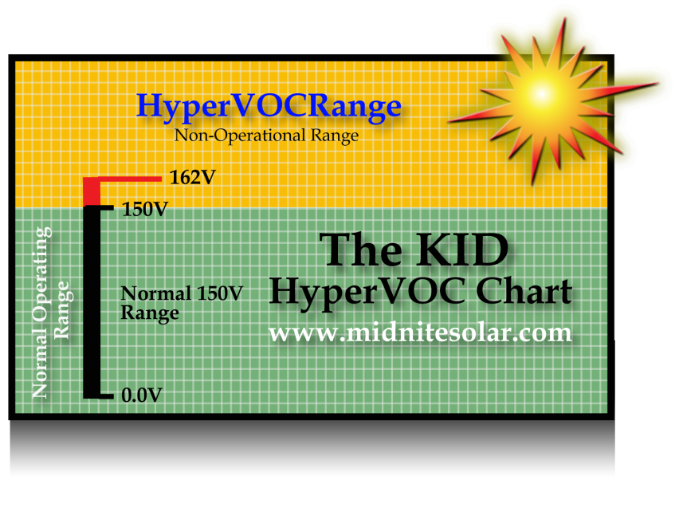
HYPERVOC
MidNite’s exclusive HyperVOC extends the maximum safe non-operating input voltage up to 162VDC.

Slide 14
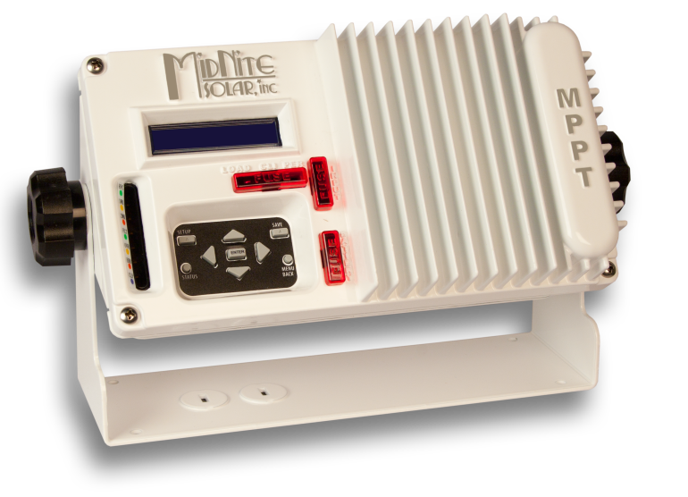
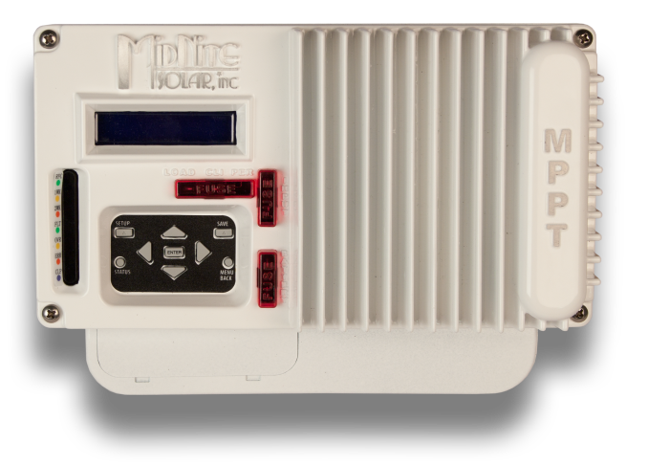
MOUNTING THE KID
With three different mounting methods; flush mount, surface mount or free standing, the KID will be the sharpest looking electronics in your home, cabin, boat or RV.

Slide 15
MIDNITE CLIPPER
The MidNite KID Clipper reduces wear and tear on the turbine by limiting RPMs to a safe level regardless of wind speed.
The KID Clipper was designed to work in conjunction with the Wind KID MPPT controller to produce the maximum possible power from your turbine or hydro system.
The KID Clipper assures safe operating voltages for the KID as well as keeping the turbine loaded so it will never free wheel.
The KID Clipper provides 3 stage charging.
The KID Clipper reduces the turbine speed down to float the batteries.

Slide 16
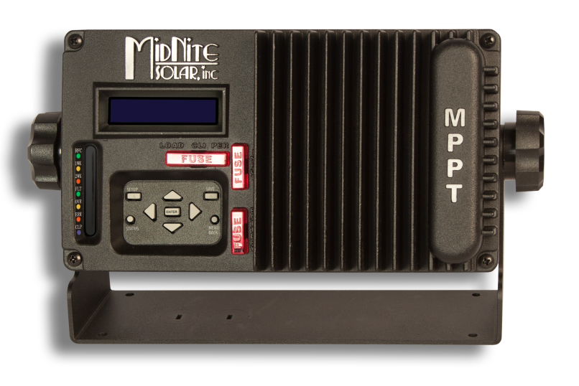
FIRMWARE UPDATES
The KID has drag and drop upgradeable firmware, making sure the KID is never out of date.
The KID’S built in USB port allows the user to upload firmware updates.
New features are easily added to the KID in the field by doing a simple firmware upgrade. Firmware upgrades will always be available on our website at no charge.

Slide 17
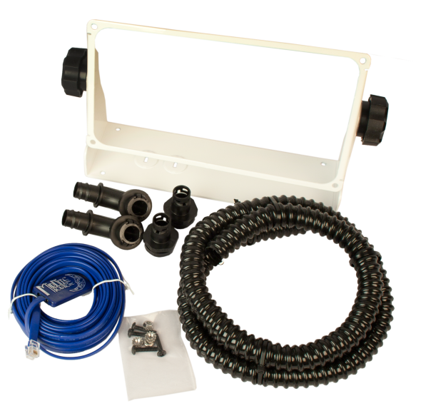
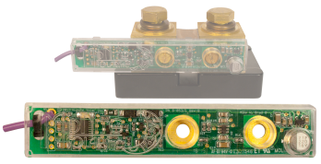
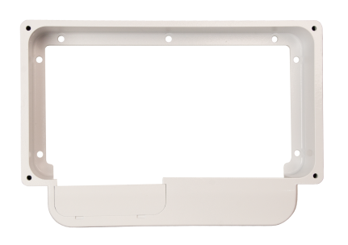
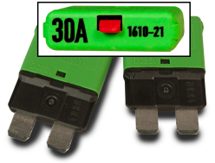
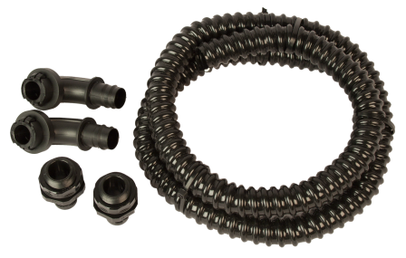
ACCESSORIES
MNKID-ASSY-KIT-W
MNKID-ASSY-KIT-B (Black) or MNKID-ASSY-KIT-W (White)
MNKID-WMB-B (Black) or MNKID-WMB-W (White)
MNKID-CDT-KIT
WHIZBANG JR
MNKID-BREAKER-30A
WHIZBANG JR.
MNKID-WMB-W
MNKID-BREAKER-30A
MNKID-CDT-KIT

Slide 18
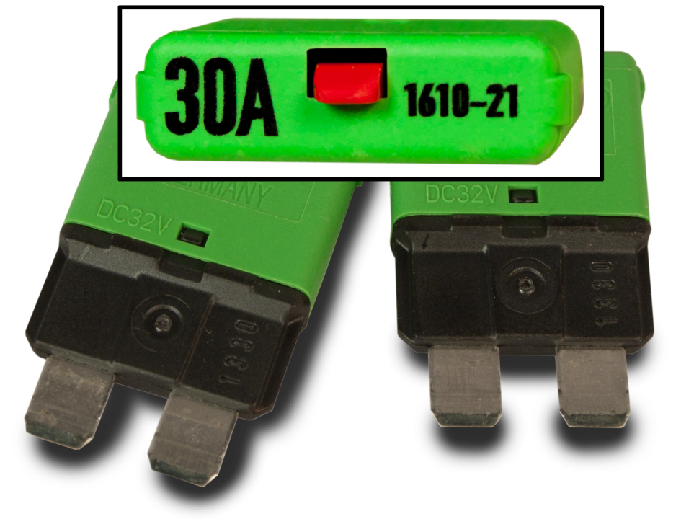
THERMAL CIRCUIT BREAKER
These miniaturized single pole press-to-reset circuit breakers extend the benefits of a circuit breaker with the style of an automotive fuse.

Slide 19
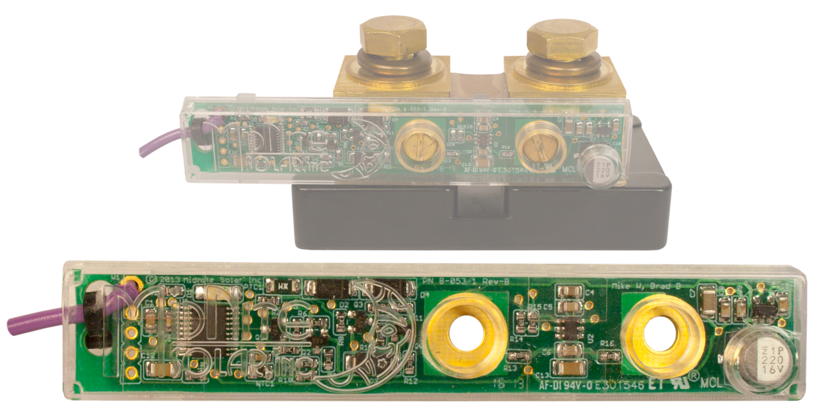
THE WHIZBANG JR.
The WB Jr. is a current sense module that attaches to a standard 50mv / 500A Shunt connected to the battery.
Charger goes to Float based on EndAmps.
State of Charge (battery fuel gauge)
Net +/- battery amp-hours logged daily

Slide 20
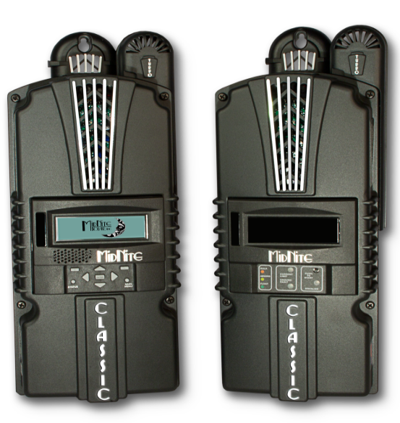
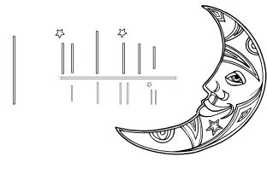
CLASSIC MPPT CHARGE CONTROLLERS
The worlds most sophisticated MPPT charge controller
BAR NONE!!!

Slide 21
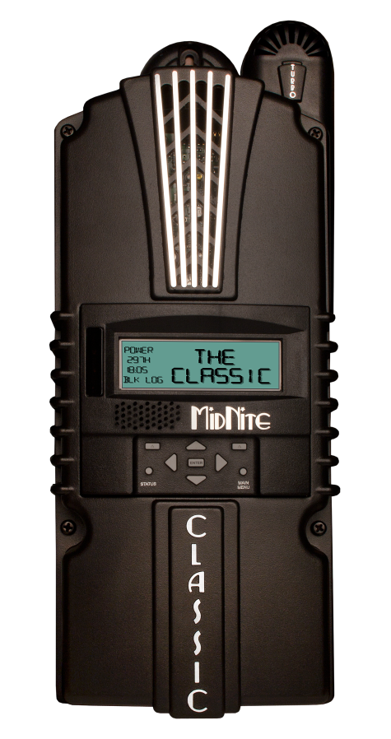
Classic 150, 200 & 250
THE CLASSICS
The Classic line of MPPT charge controllers are one of the most powerful in the RE industry. The Classics substantially increases the flexibility, features and range currently found on MPPT controllers at an incredible price. With all Classics you receive reliability, functionality and an incredibly powerful MPPT charge controller.
FEATURES
150, 200, 250 Operating Voltage
12-72V battery charging standard
DC-GFP and Arc Fault Protection
Solar, Wind and Hydro modes
Exclusive HyperVOC extends VOC limits
Manual and Auto EQ
Full Internet Capable
Remote and local displays possible
380 days of daily history, 24 hours of data a 5 minute intervals
Communications – Ethernet, Modbus and RS232
Parallel operation for multiple Classic systems
ETL listed for the USA and Canada
Made in America

Slide 22
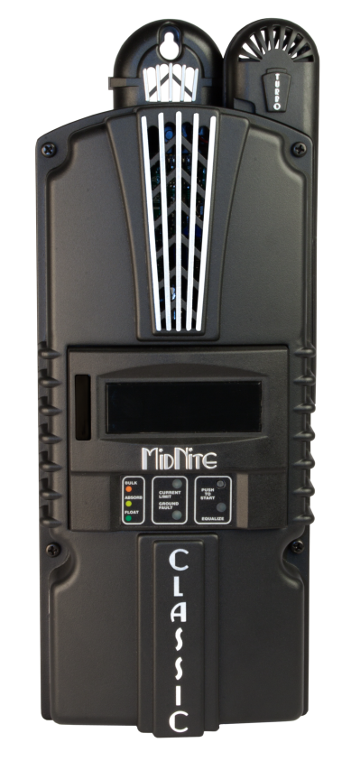
Classic LITE 150, 200, 250
THE CLASSIC LITE
The Classic Lite line of MPPT charge controllers has all the power of the Classics have but at a reduced price. The Classic Lite, like the Classic, can charge from 12 to 72 volt batteries with output up to 96 amps. Why would you choose a lesser controller for your system?
All Classics have free upgradeable firmware, making sure these units never are out dated.
FEATURES
150, 200 & 250 Operating Voltage
Dip switch programming
12-72V battery charging standard
Solar, Wind and Hydro modes
Exclusive HyperVOC extends VOC limits
Manual and Auto EQ
Full Internet Capable
Works with the Classic MNGP remote display
LED indicators for charge state (Bulk, Absorb and Float)
380 days of daily history, 24 hours of data a 5 minute intervals
Communications – Ethernet, Modbus and RS232
Parallel operation for multiple Classic systems
ETL listed for the USA and Canada
Made in America

Slide 23
Solar, wind & hydro
SOLAR, WIND & HYDRO
All Classics are Solar, Wind and Hydro capable. The Classic has several different tracking algorithms. This allows it to work with Solar, Wind and Hydro. Each mode is fully adjustable to allow the user to fine tune to their input source.

Slide 24
communications
ETHERNET MODBUS & RS232
The Classic uses a published Modbus Protocol allowing users to interface with the Classic. Modbus allows you to tailor your own software to communicate with your Classic. The Classic speaks Modbus over RS232 or TCP/IP
MidNite also offers software for communicating with the Classic.

Slide 25
Dc-gFp & arc fault protection
DC-GFP & ARC FAULT
The Classic’s DC-GFP and Arc Fault capabilities are at the fore front of the industry saving you time, space and money. The Classic is the worlds only Arc Fault detecting controller and comes standard in all models except the Classic Lite.
Ground fault protection is a built-in feature on the Classic and Classic Lite.
The Classic is made to work in conjunction with our new GFP breaker assembly.
Arc Fault detection is required by NEC code.

Slide 26
Auto or manual eq
AUTO OR MANUAL EQ MODES
The Classic has 2 modes you can use to Equalize the battery. Either manual or auto.
Auto EQ has a user adjustable interval between EQ charges as well as a “Days” function to retry if the EQ did not complete on the first day.

Slide 27
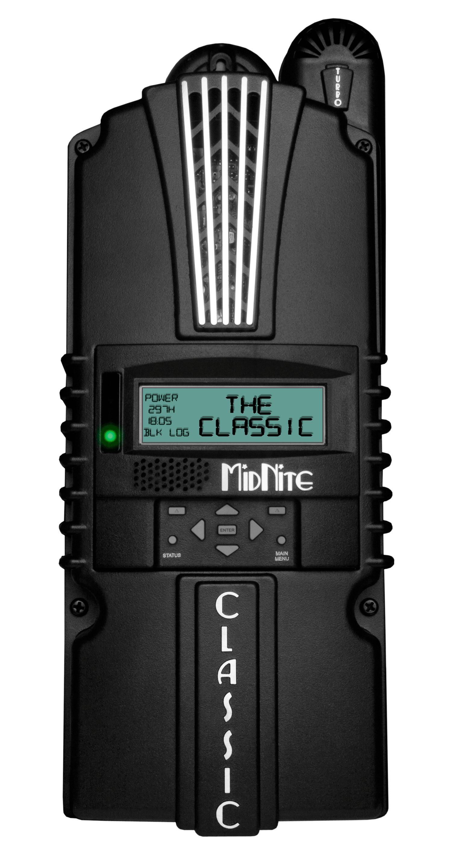
LED MODES
CLASSIC LED MODES
The Classic has several LED indicators that can be programmed to display a variety of information.
OFF : No LED activity
Rick Mode: Displays errors only
LED Mode1 - Aux 1 and 2 indicators: Displays errors and warnings as well as a FLoat indicator
Blinky Mode: LEDs cycle around in a loop (good for discos and parties)

Slide 28
Firmware updates
UPGRADEABLE FIRMWARE
All Classics have free upgradeable firmware, making sure these units never are out dated.
The Classic’s built in USB port allows the user to upload firmware updates. USB cable included.
New features are easily added to the Classics in the field by doing a simple firmware upgrade. Firmware upgrades will always be available on our website for no cost to every Classic owner for life.

Slide 29
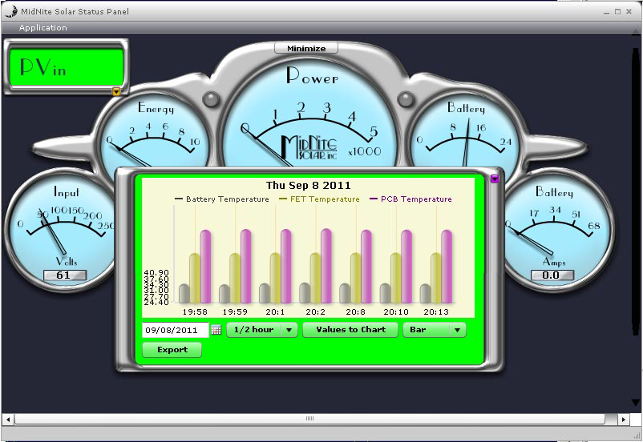
LOCAL APP
MONITORING YOU CLASSICS
Graphs and data are displayed on your PC using the “Local App”.
Graphs can be displayed by Line, Bar, Round and Sketch.
VALUES THAT CAN BE CHARTED
Battery Voltage
kWh
Total kWh
FET Temperature
Input Voltages
Watts
Total Amp Hours
PCB Temperature
Battery Current
Input Current
Battery Temperature

Slide 30
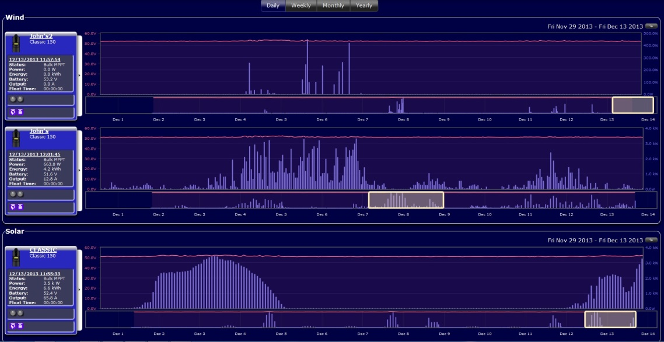
MYMIDNITE.COM
INTERNET MONITORING
My MidNite is a free web based monitoring solution that MidNite Solar offers to its customers. It allows you to monitor your charge controller from anywhere you have Internet access. You simply plug the Classic into the Internet, go to My MidNite and register for an account.
My MidNite allows you to chart values, download data and much more. In the very near future My MidNite will allow for email and SMS alerts and system status reports. It will also allow for guest accounts as well as installer accounts.

Slide 31
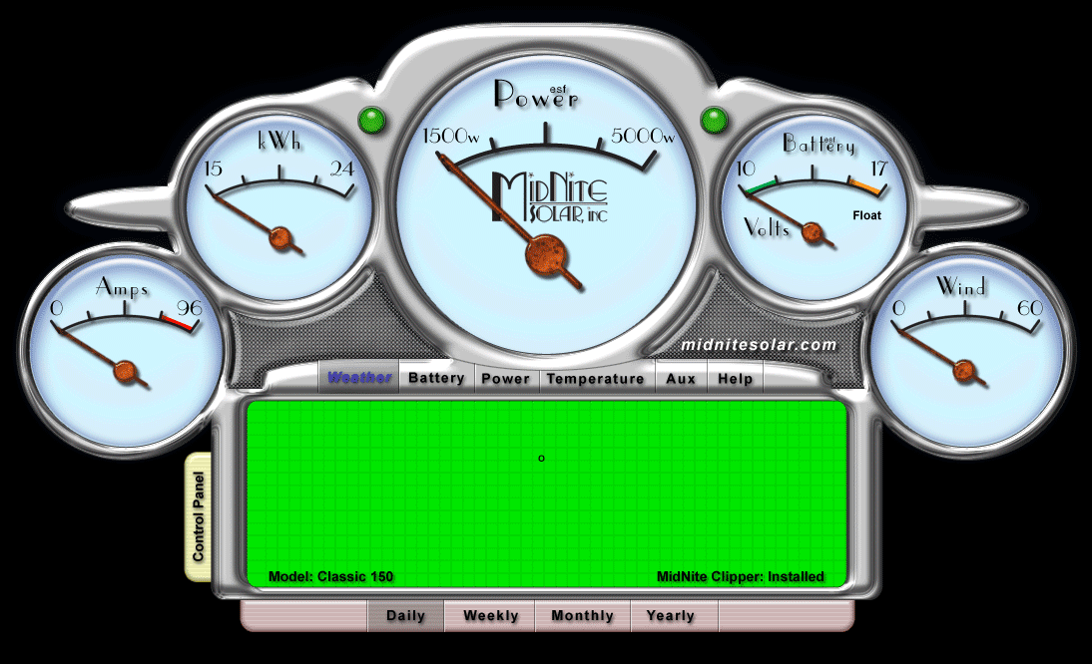
Data logging and graphing
ALL THE DATA
All Classics log 380 days of data in its daily logs.
The Classic logs data points every 5 minutes in its Recent Logs. These are viewable from the Display on the Classic.
The Classic has Graphing capabilities on its display as well.

Slide 32
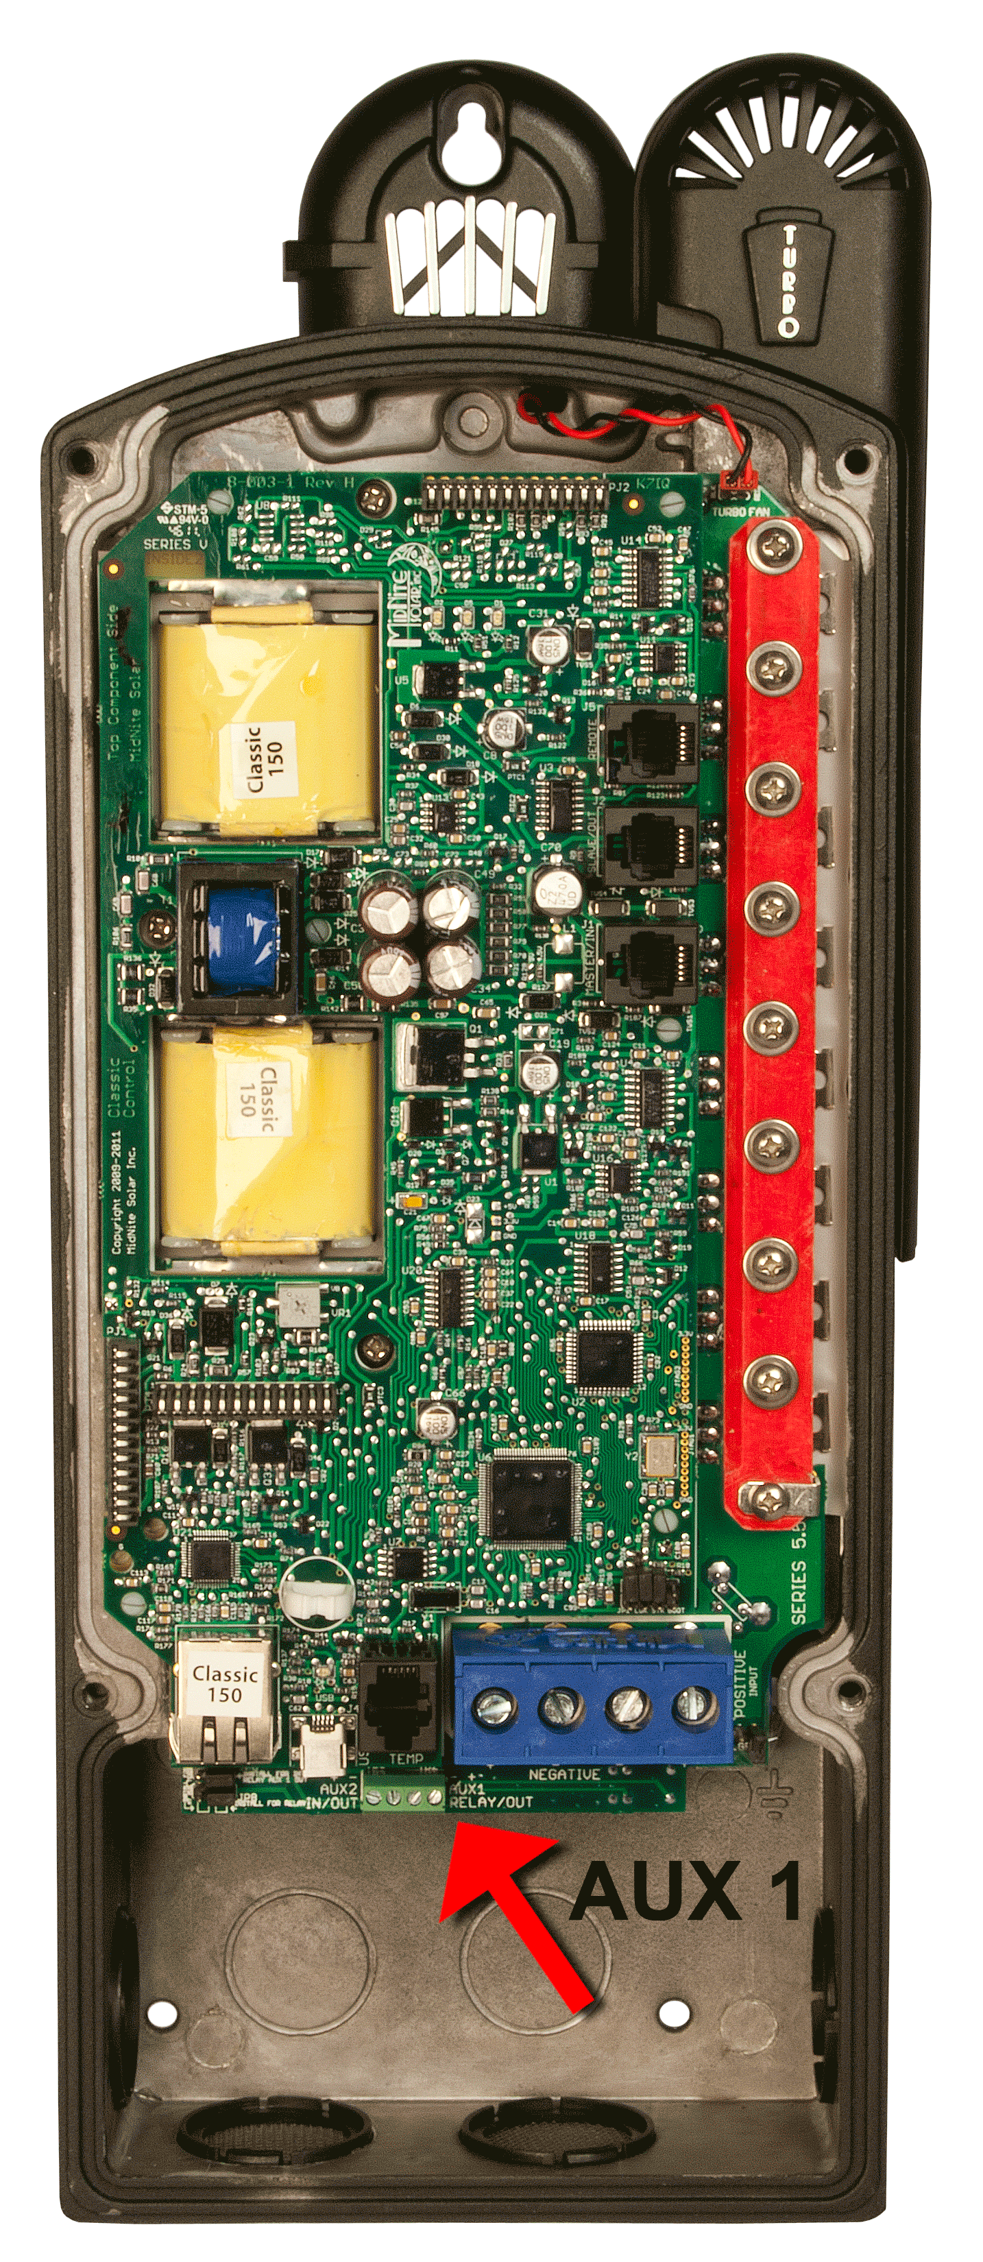
Auxiliary outputs
Auxiliary 1 and 2.
Auxiliary 1 can be configured as a 12VDC signal out or as a rely contact. Auxiliary 2 can be used as an output or as an input.
Aux 2 supplies a PWM signal.
AUXILIARY FUNCTIONS AVAILABLE
Vent Fan low and Vent Fan high
Float low and Float high
Clipper Control
Day Light
Nite Light
Toggle Test
PV Voltage on low
PV Voltage on high
Waste Not low
Waste Not high
Low battery disconnect
Diversion

Slide 33
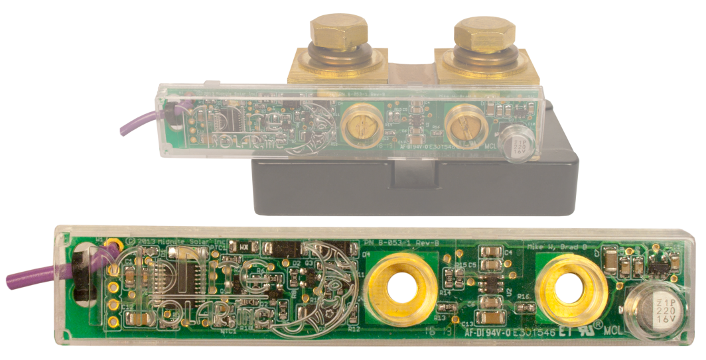
Battery monitoring
WHIZBANG JUNIOR
The Whizbang Junior is a current sense module that attaches to a standard 50mv / 500A Shunt. The Whizbang Junior wires into the Classic and KID charge controllers to give Amperage readings from the shunt. The Whizbang Junior also gives us a full featured SOC meter. The Whizbang Junior allows for EndAmps to function based on system amps if desired.
For our customers that already own similar monitoring products, the Whizbang Junior has been designed for cooperative attachment.

Slide 34
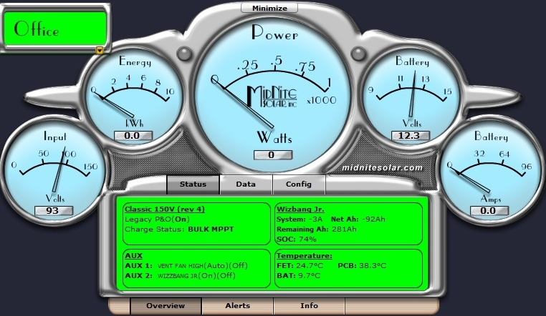
STATE OF CHARGE
The WBjr gives us a full featured Battery Monitor. This can be viewed on the Classics Display as well as on the Local App software. The Local App works with Mac and Windows and we will be releasing a version for Android and iPhone Late Jan of 2014

Slide 35
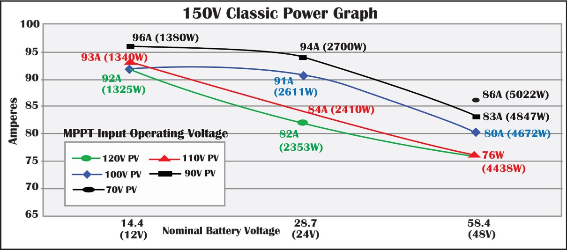
Classic 150 & Classic Lite 150 Power Graph
150 power graph
The Power Graphs on this slide and the following display the relation between input voltage, battery voltage and output current. Using and understanding these graphs will help when designing the most efficient system and choosing the correct Classic for the task at hand.

Slide 36
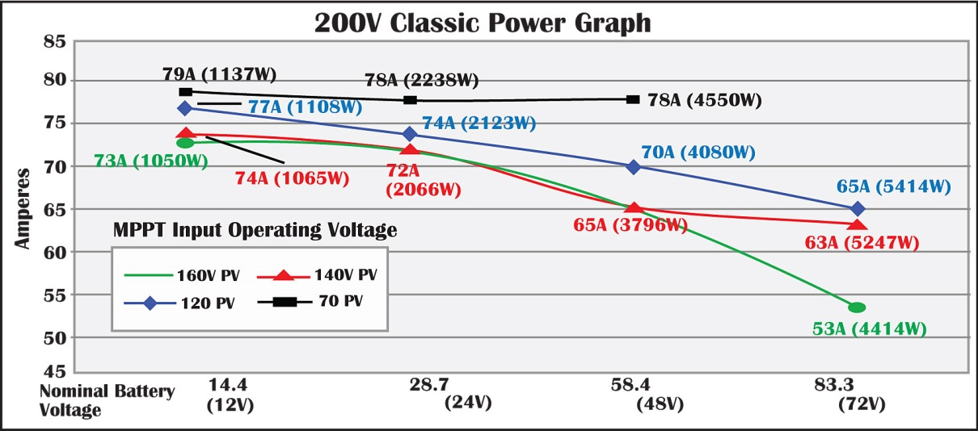
200 power graph
Classic 200 & Classic Lite 200 Power Graph
These graphs display efficiency differences between lower input voltages compared to higher levels along with the balance between wire length and input voltage.

Slide 37
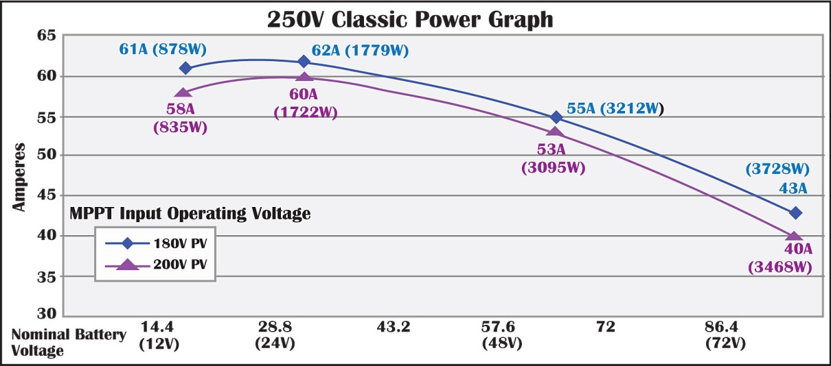
250 power graph
Classic 250 & Classic Lite 250 Power Graph
The Higher voltage Classics can be useful when the PV array is a long distance from the Charge Controller. Offering smaller wire but still allowing for an affordable fully featured controller.

Slide 38
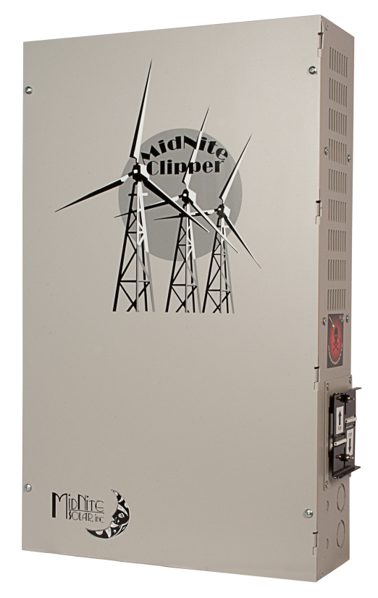
Midnite clipper
The MidNite Clipper will reduce wear, tear and noise on your turbine.
The MidNite Clipper was designed to work in conjunction with the Classic MPPT controller to offer safe and reliable control of your turbine may it be wind or hydro.
The Clipper assures safe operating voltages for the Classic as well as keeping the turbine loaded so it will not free wheel.
The Clipper allows 3 stage charging and will reduce wear and tear on your turbine.

Slide 39
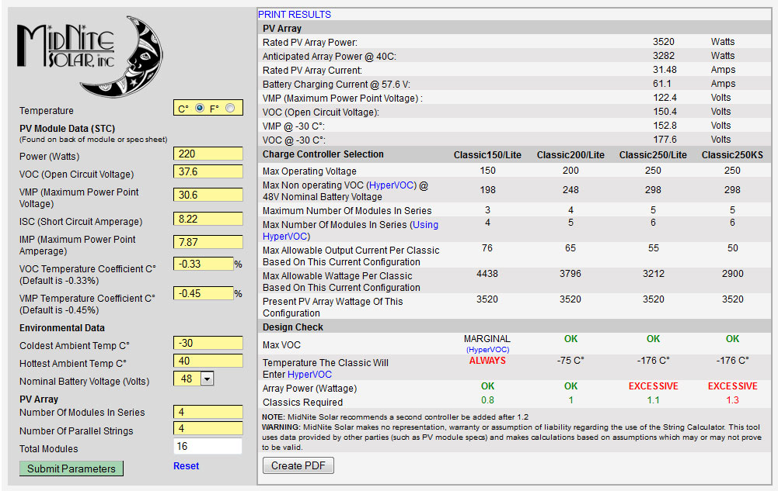
CLASSIC STRING SIZING TOOL
The Classic String Sizing Tool helps design the array.
The string sizing tool determines the best Classic model to use and the number Classics needed. It can be found on MidNite’s website.

Slide 40
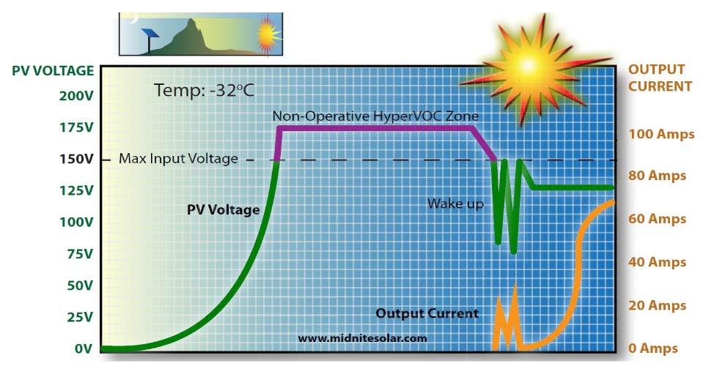
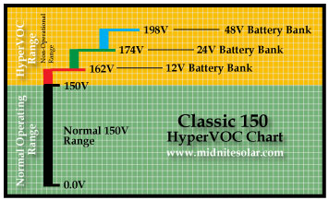
CLASSIC & Classic Lite Hypervoc
HyperVOC, a non-operative VOC safety zone over and above the maximum input voltage.
On cold mornings the PV panels will put out full voltage even before you can see the sun. Ambient light may not have much current behind it but it does have voltage exceeding the possible voltage limits that destroy the controller. The MidNite Solar controller gives you bonus headroom for those cold mornings that would potentially destroy any other controller.

Slide 41
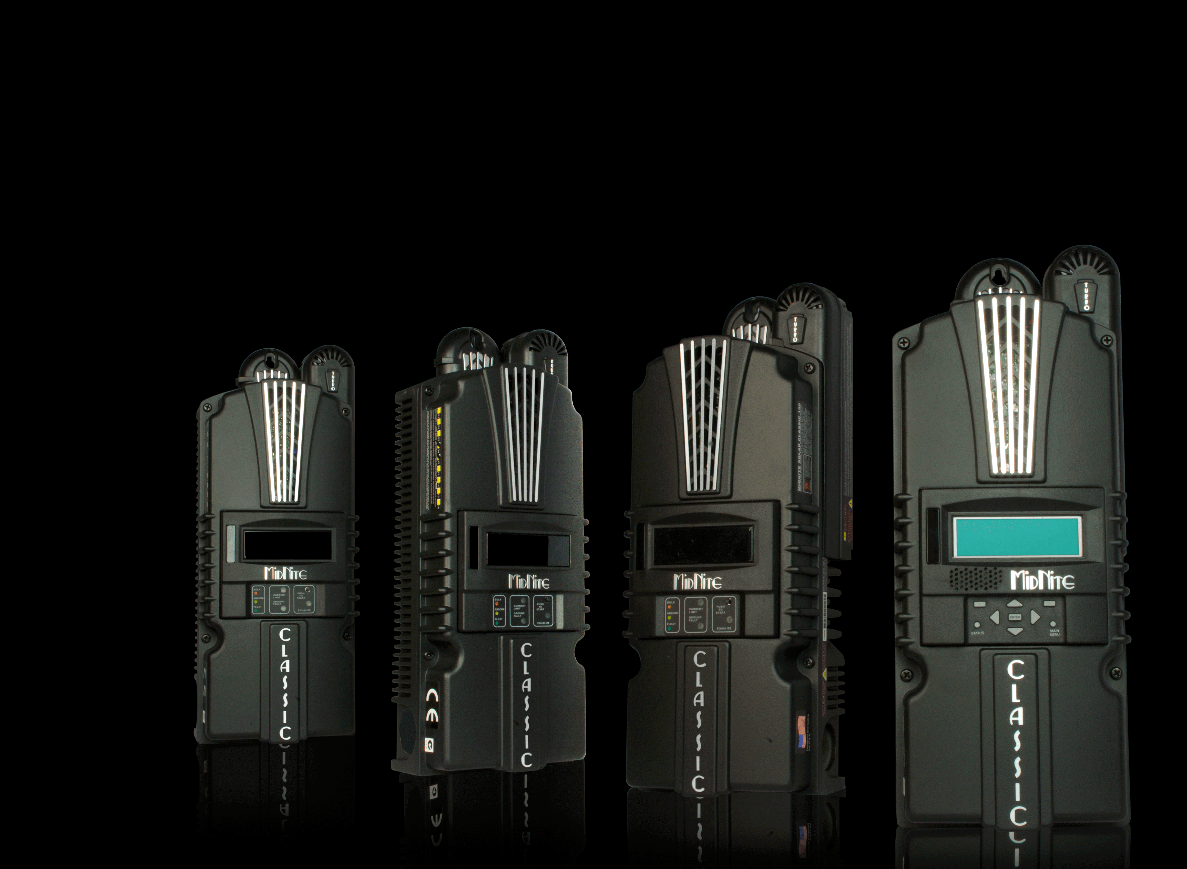
CLASSIC follow me
Follow me allows Classics to talk to each other.
"Follow Me" allows the Classics to share charge stages, as well as battery temperature info and Ground Fault coordination. “Follow Me” also allows you to program a single Classic for Auto Equalize and it will instruct all the others to Equalize as well.
Any system with 2 or more charge controllers must have a coordinated charge or the batteries could be destroyed.

Slide 42
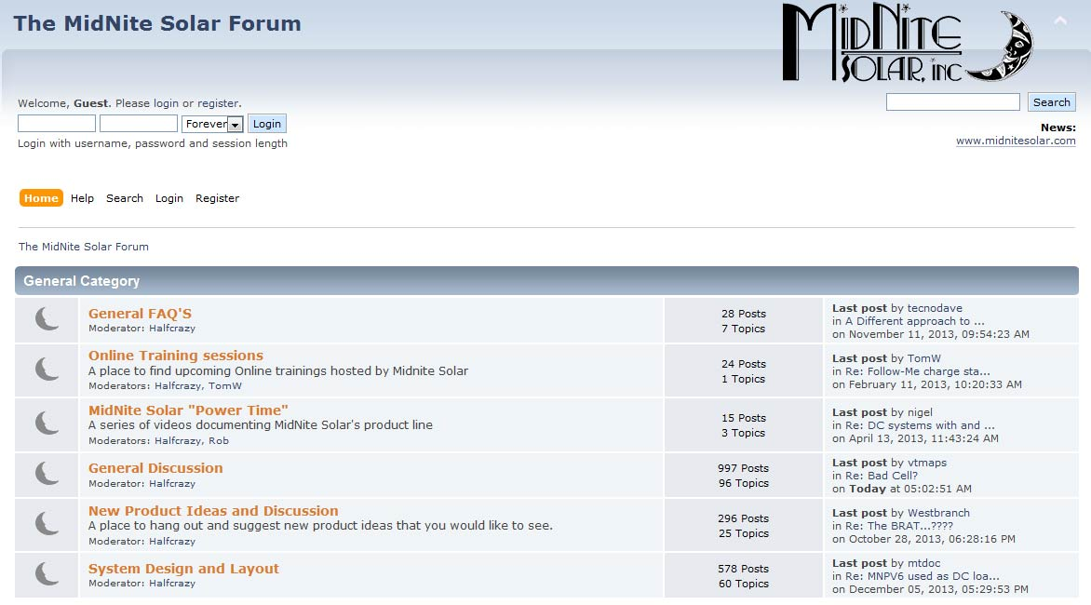
Tech support
MidNite Solar Support
MidNite has superior tech support with contact information at www.midnitesolar.com. If you call you will talk to a real person.
There are videos, webinars and a variety of help documents in the “Documents” section of the website as well.
The Forum has many vital discussion topics that can help with your questions. Check it out on MidNite’s website.

Slide 43
MIDNITE SOLAR INC
17722 – 67TH Ave NE
Arlington, WA 98223
Ph. 360-403-7207
Fax 360-691-6862
info@midnitesolar.com

